Slide 1

Cykid128 @ SITCON X
高效能遊戲圖形 從 0 開始的 Renderer

Slide 2
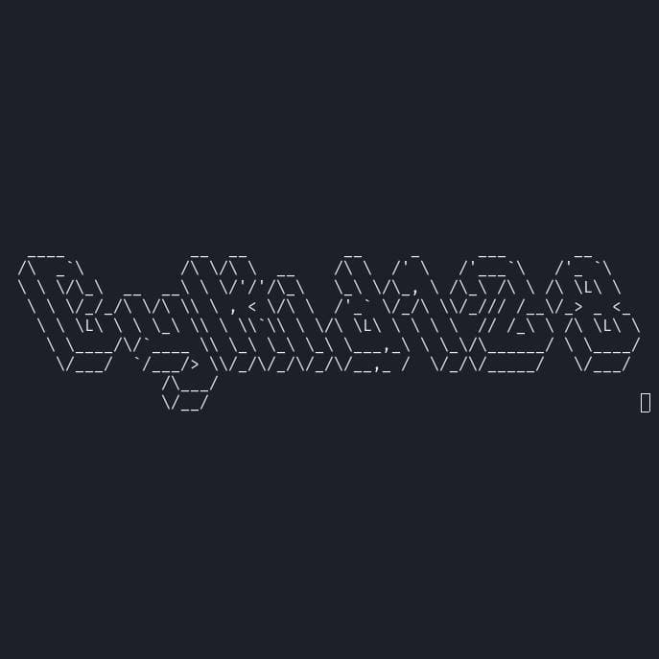
whoami
ID: alanjian85/ Cykid128
準高一生
圖學愛好者
Email: alanjian85@outlook.com
Github: https://github.com/alanjian85

Slide 3
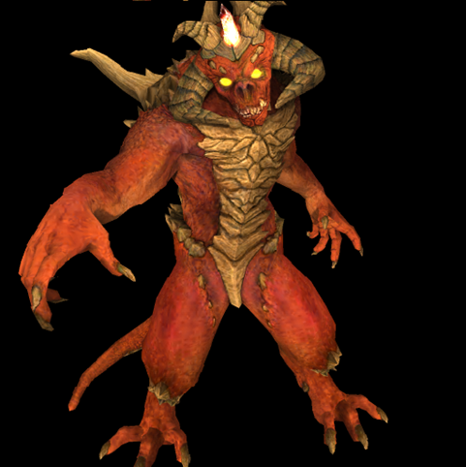
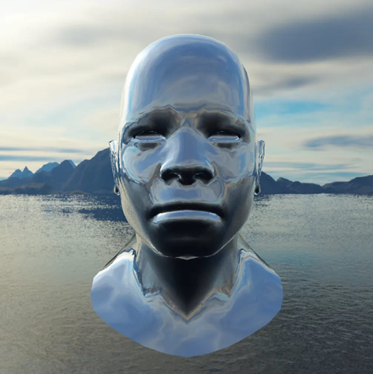
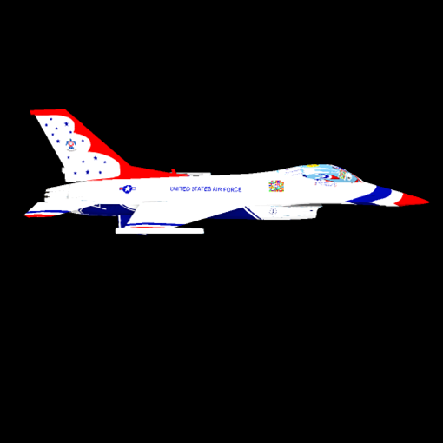
Showcase

Slide 4
Contents
Introduction
Renderer Workflow
Primitive Renderering Algorithms
Lighting
Modern Graphics Pipeline
Practical Techniques

Slide 5
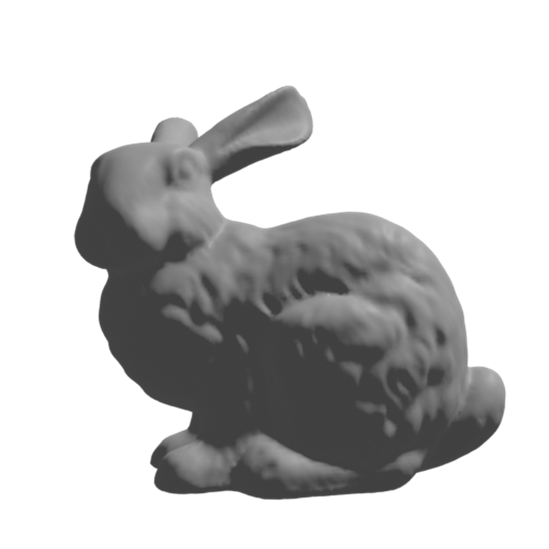
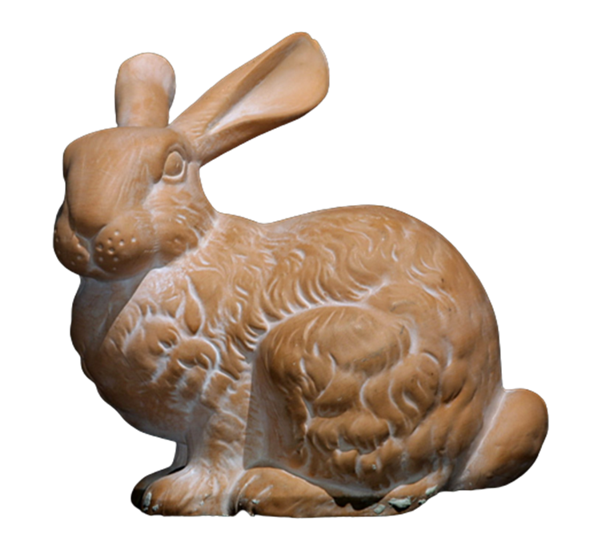
What is Rendering
Rendering
Scene Reconstruction

Slide 6
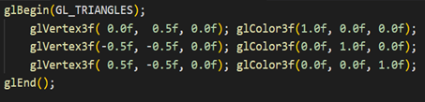
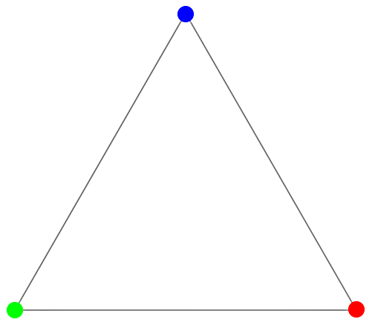
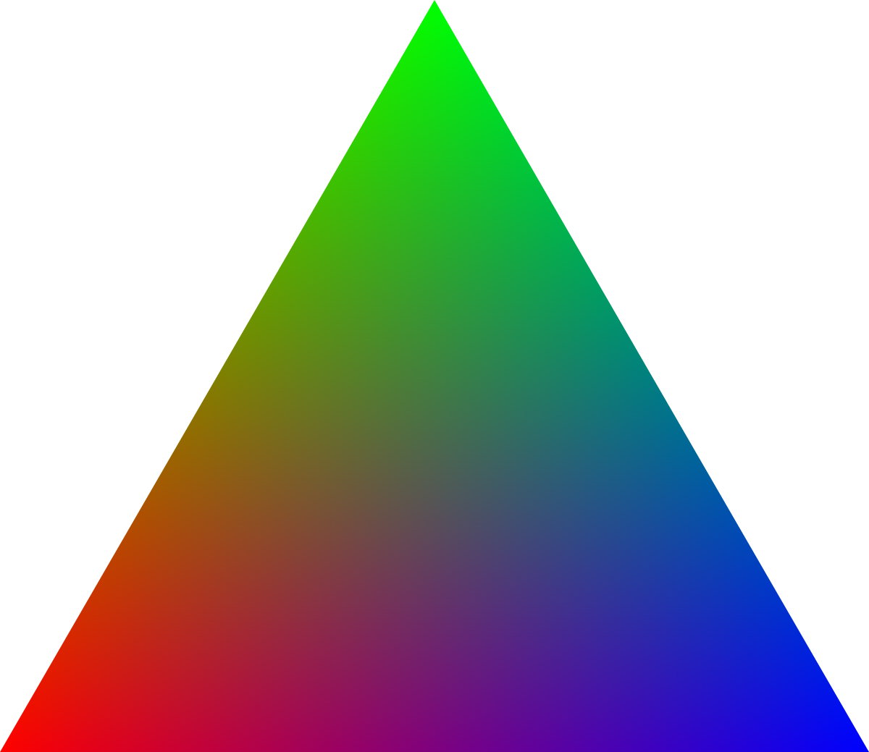
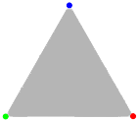

Fixed-Function Pipeline
Primitive Assembly
Vertex Data
Transform
& Lighting
Per-Sample Operations
Pixel Processing
Rasterization

Slide 7

Coordinate Systems
Left-Handed
Right-Handed

Slide 8
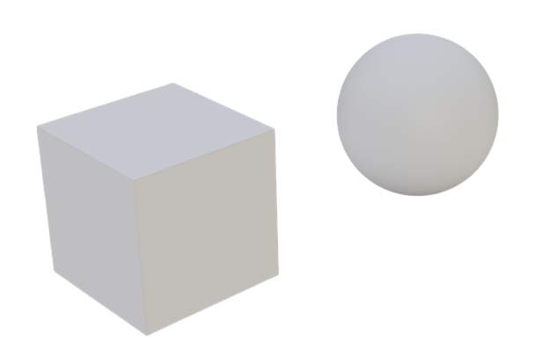
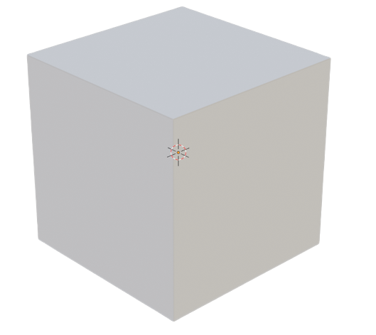
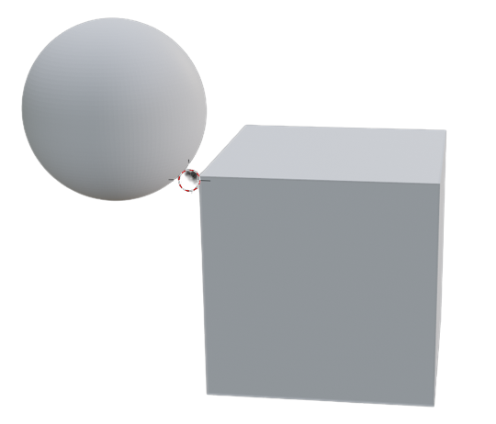
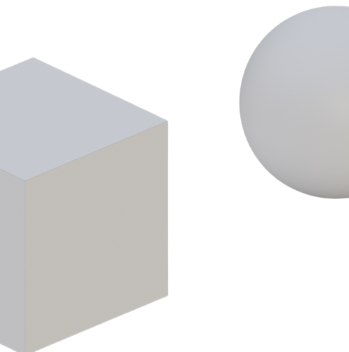
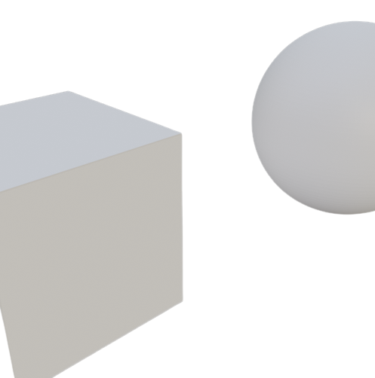
Coordinate Systems
Model Matrix
View Matrix
View Space
World Space
Local Space
Projection Matrix
Viewport Mapping
Perspective Division
Screen Space
Normalized Device Coordinate(NDC)
Clipping Space

Slide 9
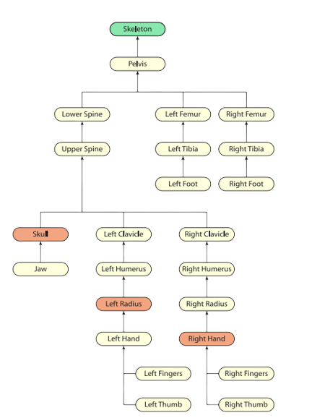
Local Space

Slide 10
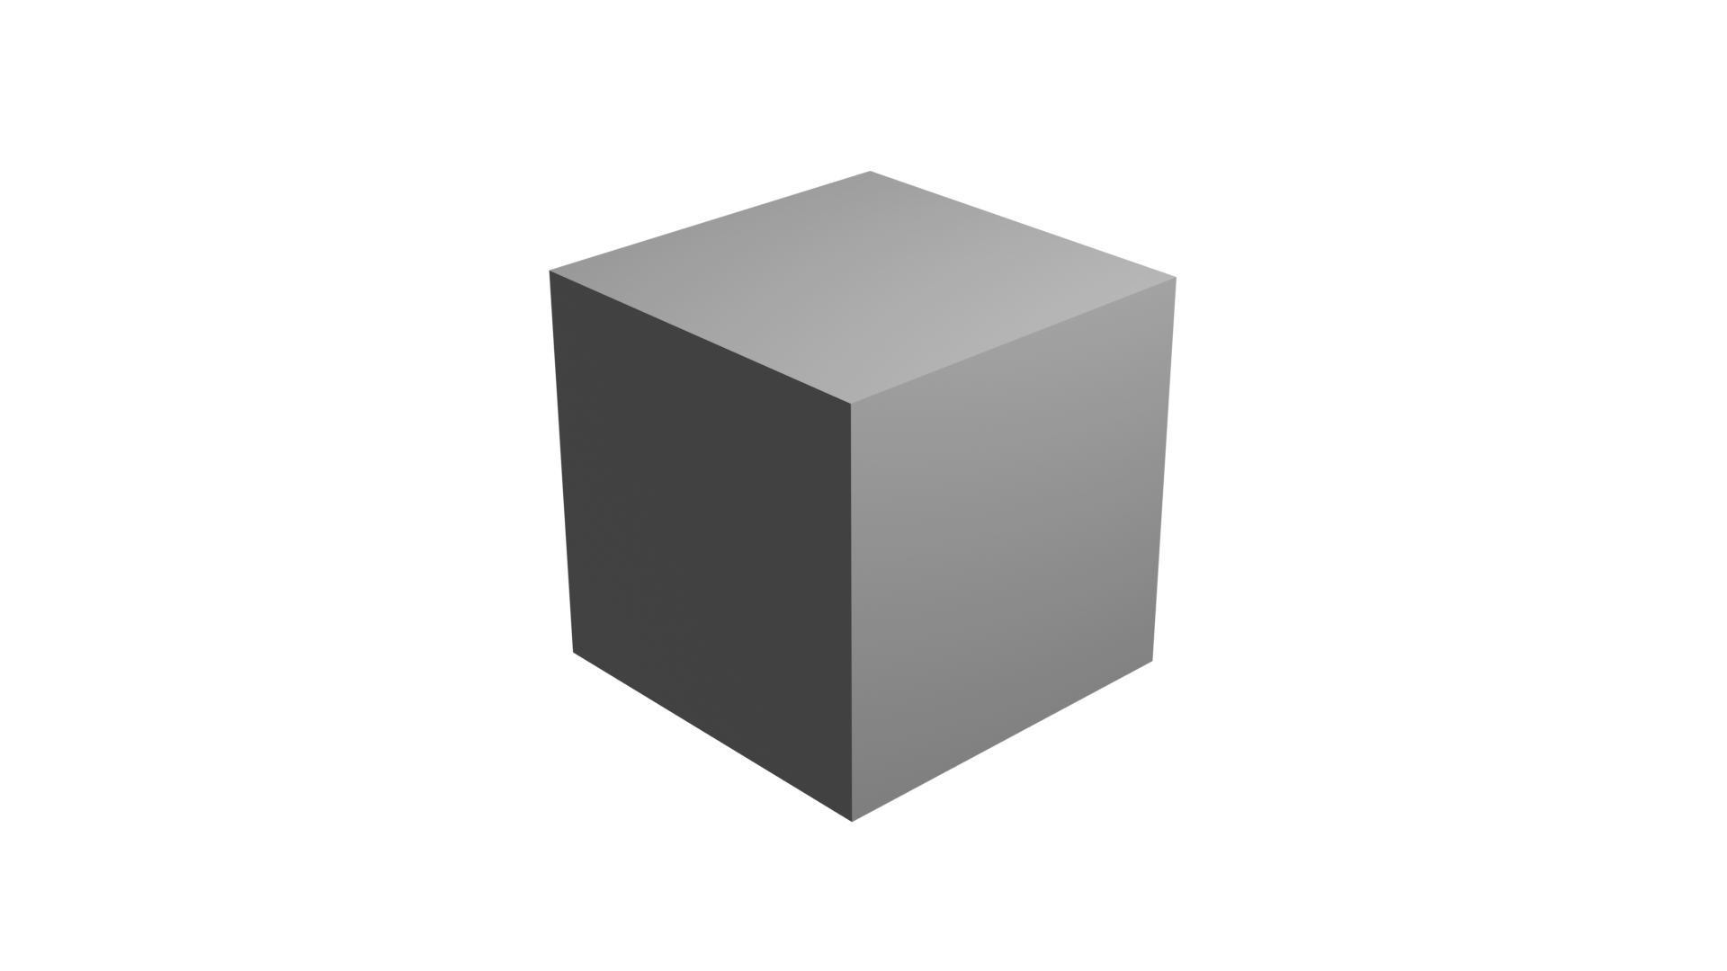
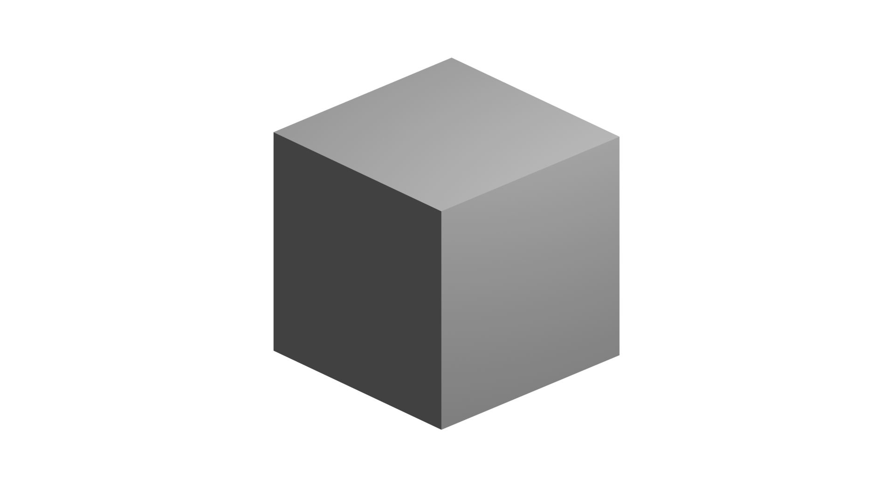
Projection
Perspective
Parallel

Slide 11

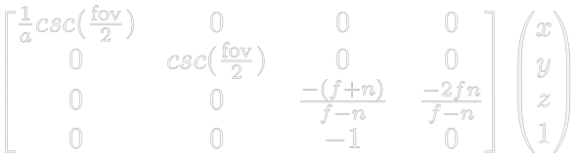
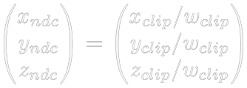
Perspective Division

Slide 12


Homogeneous Coordinate Clipping
Polygon Inversion
Divide by 0

Slide 13
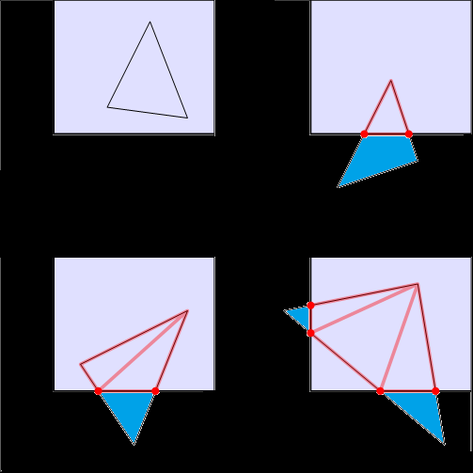

Homogeneous Clipping
Clip To Planes(Left-Handed):
Right (x / w = 1)
Left (x / w = -1)
Top (y / w = 1)
Bottom (y / w = -1)
Front (z / w = 1)
Back (z / w = -1)

Slide 14
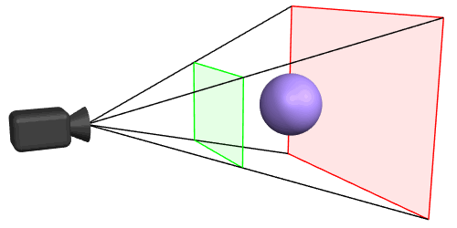
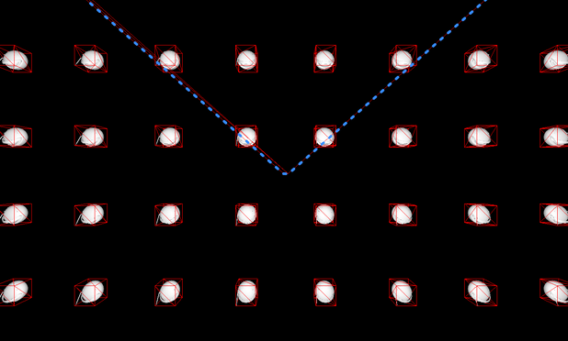
Frustum Culling

Slide 15
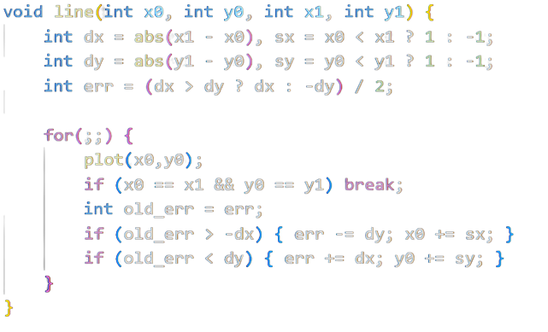
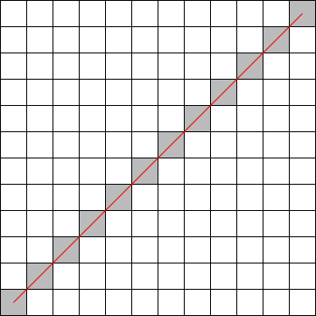
Bresenham’s Line Algorithm

Slide 16
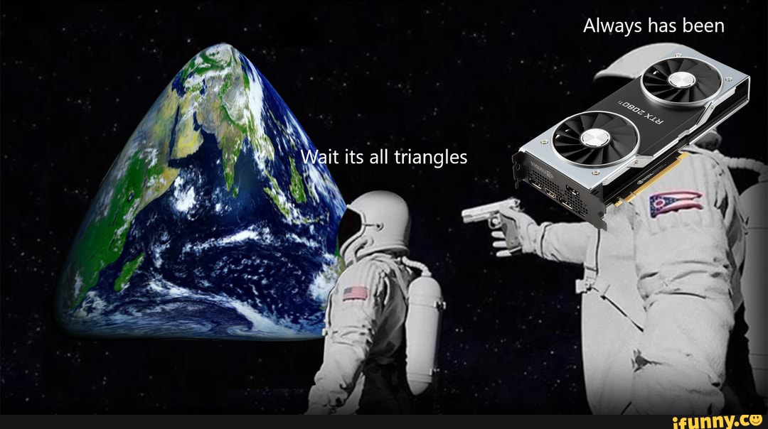
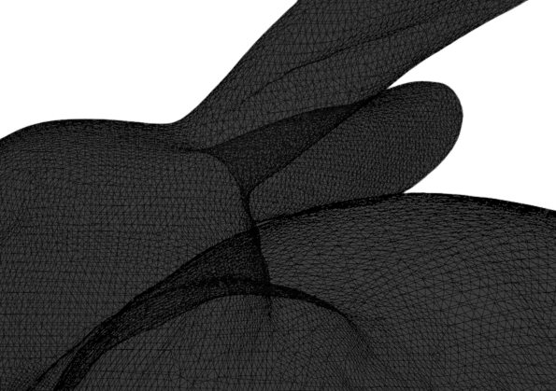
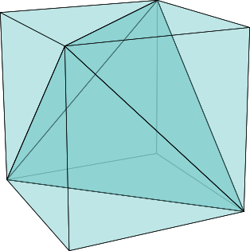
Triangulation

Slide 17
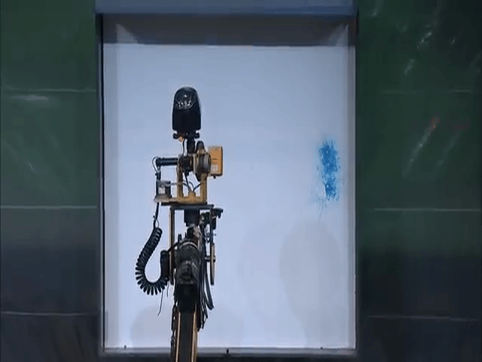
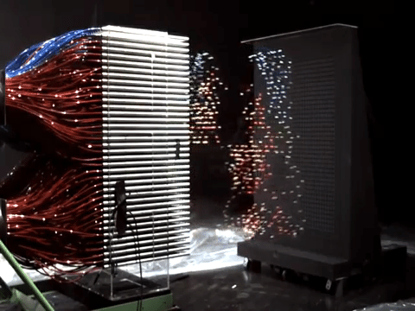
CPU vs GPU
As technology advances, rendering time remains constant. —Blinn’s Law

Slide 18
Scanline Algorithm vs
Barycentric Coordinate
Pros:
More Simple
Cons:
Sequential Execution
Pros:
Embarrasingly Parallel
Cons:
Slower on CPU

Slide 19
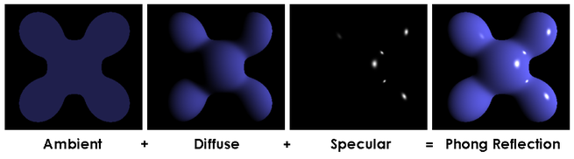
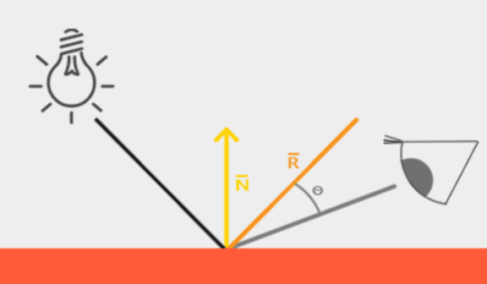



Phong Shading Model

Slide 20
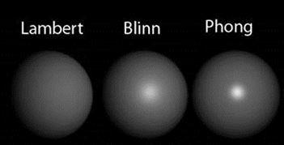
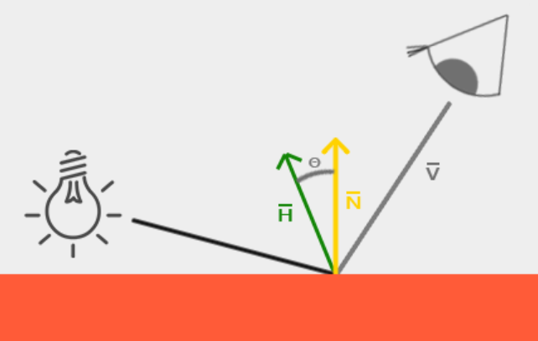
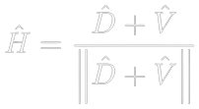
Blinn-Phong Shading Model

Slide 21
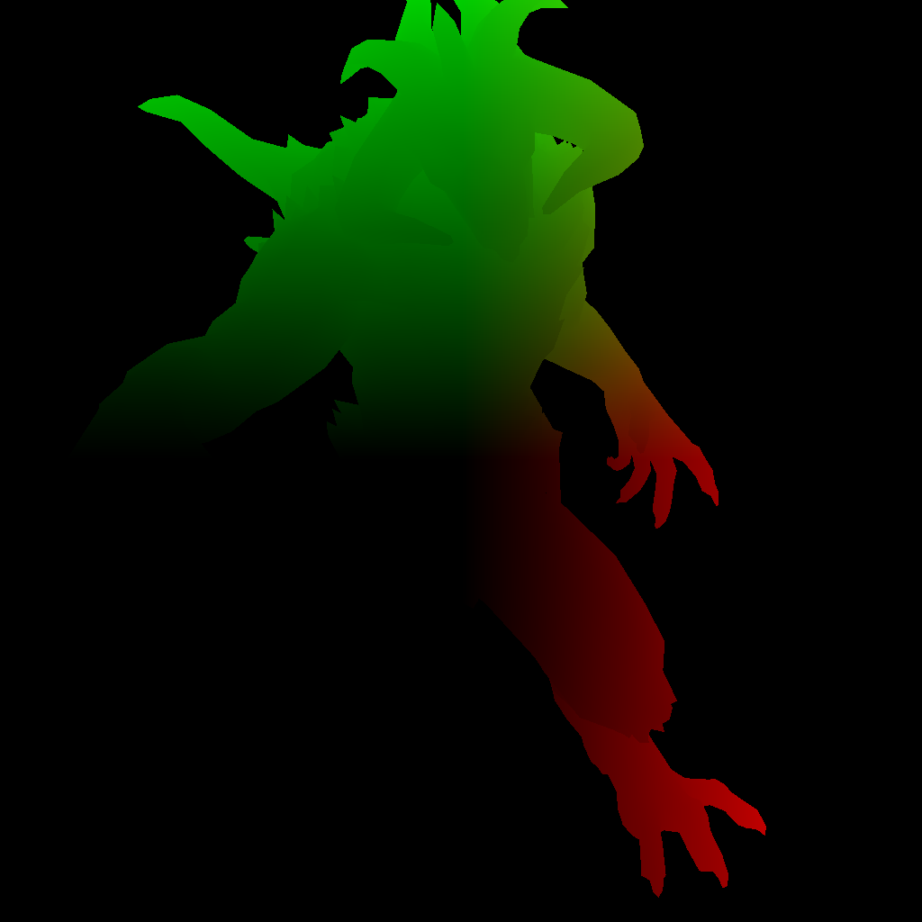
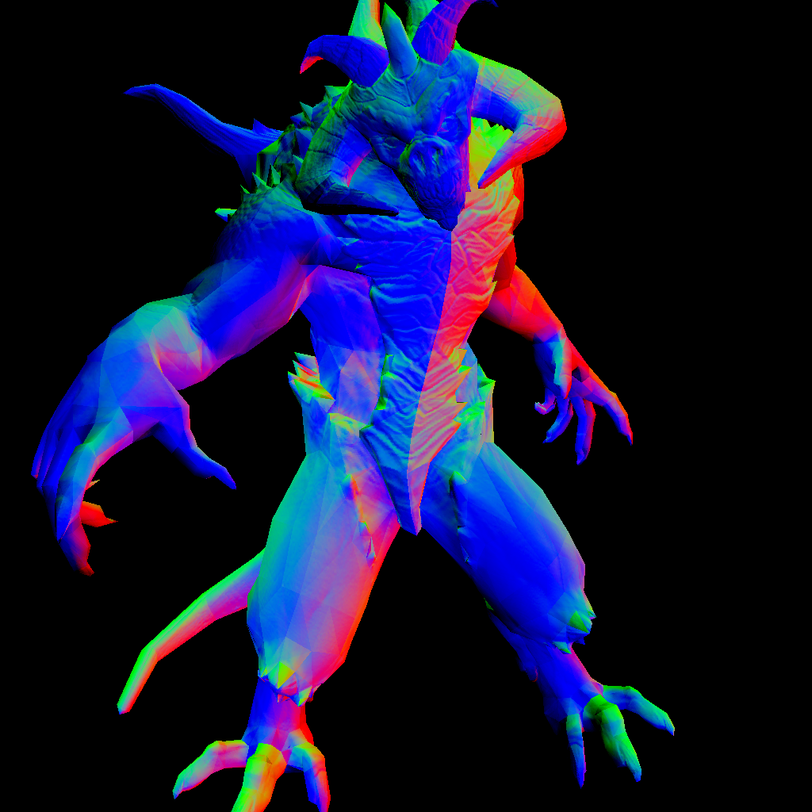
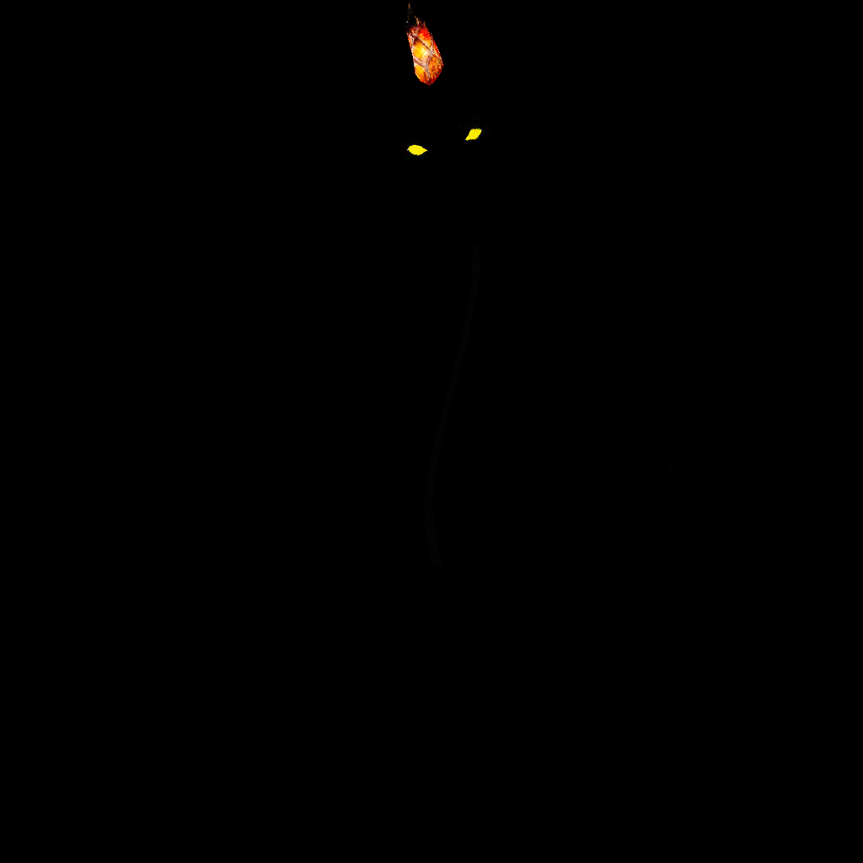
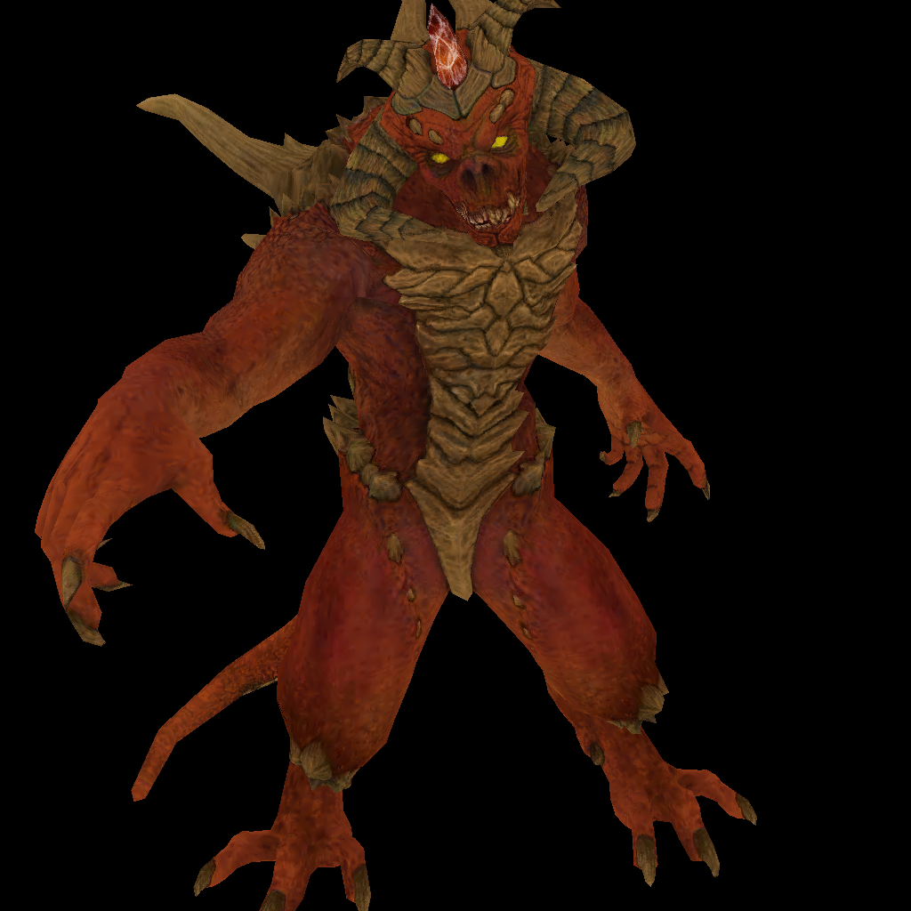
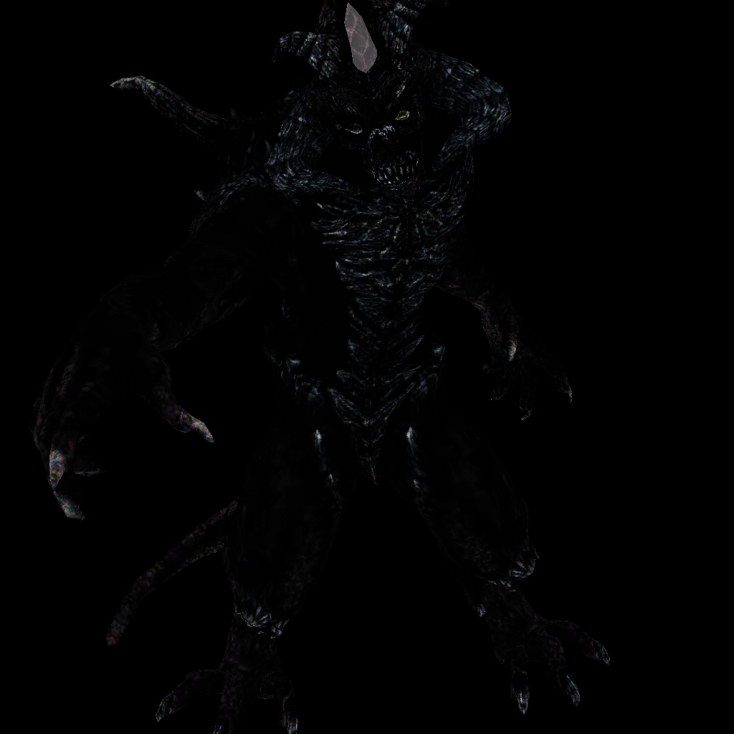
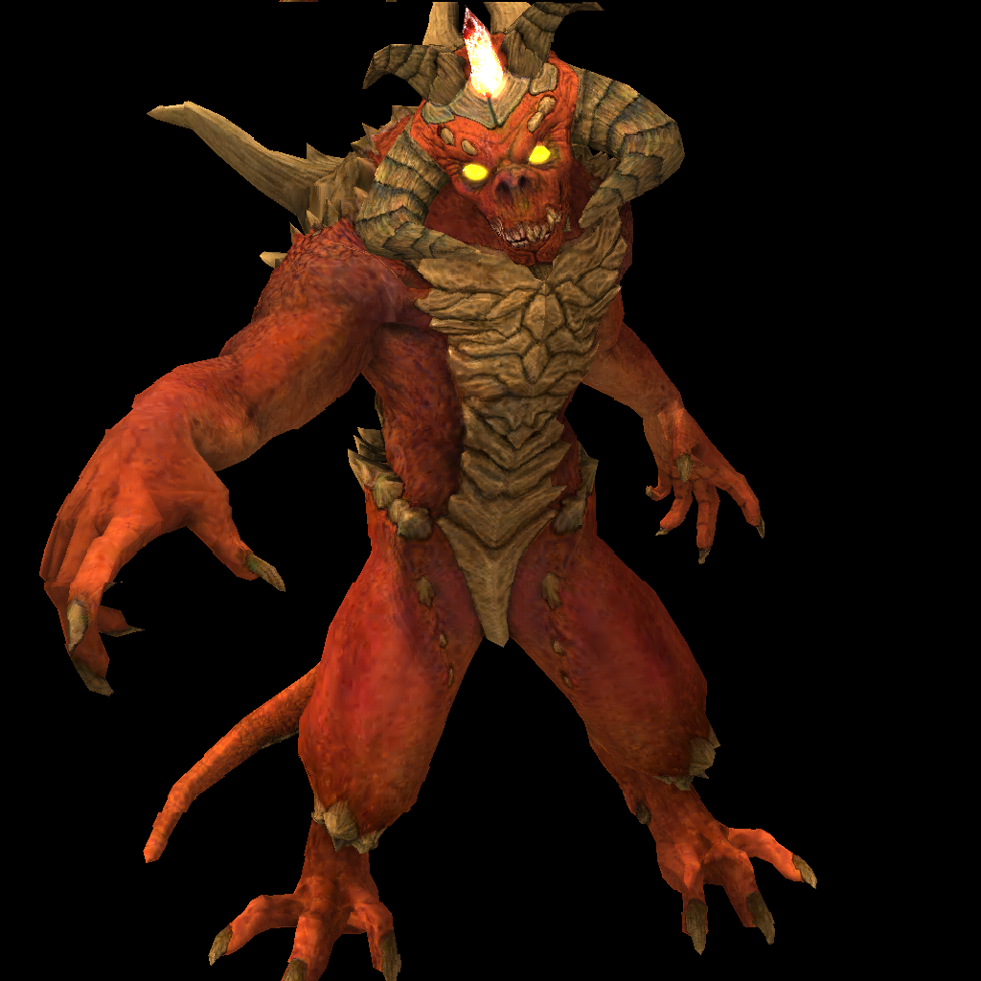
Deferred Shading
Position
Normal
Emission
Albedo
Specular

Slide 22
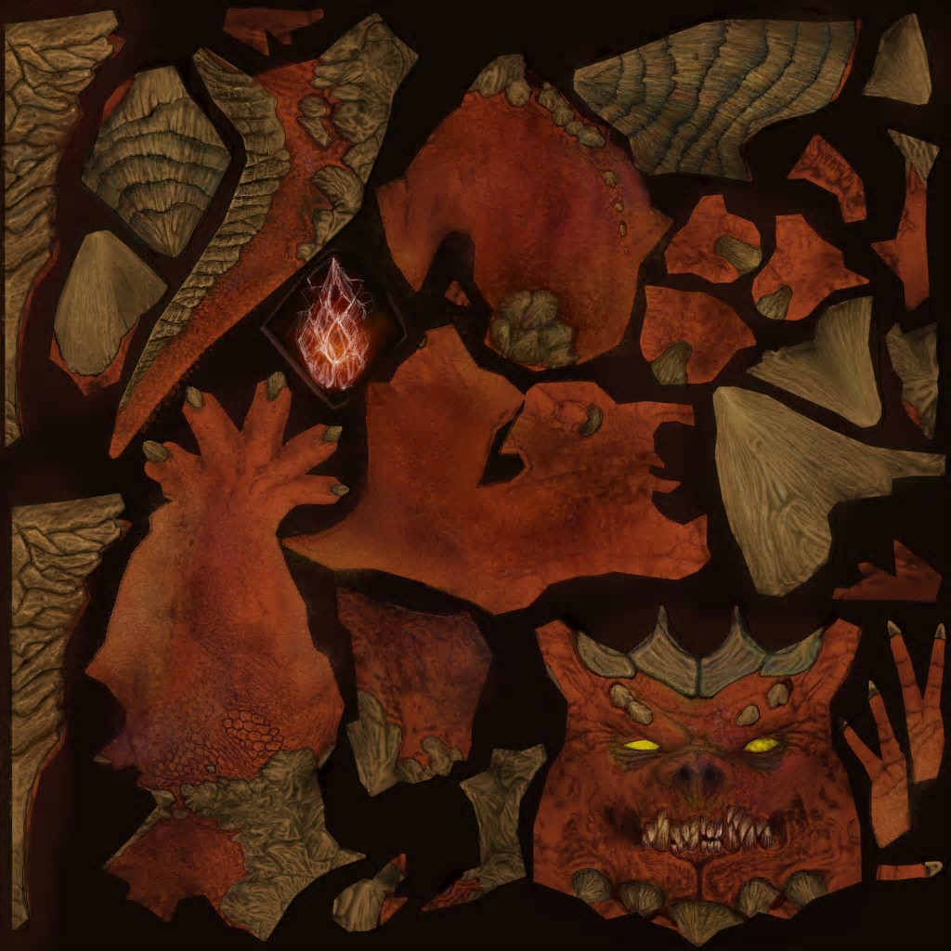
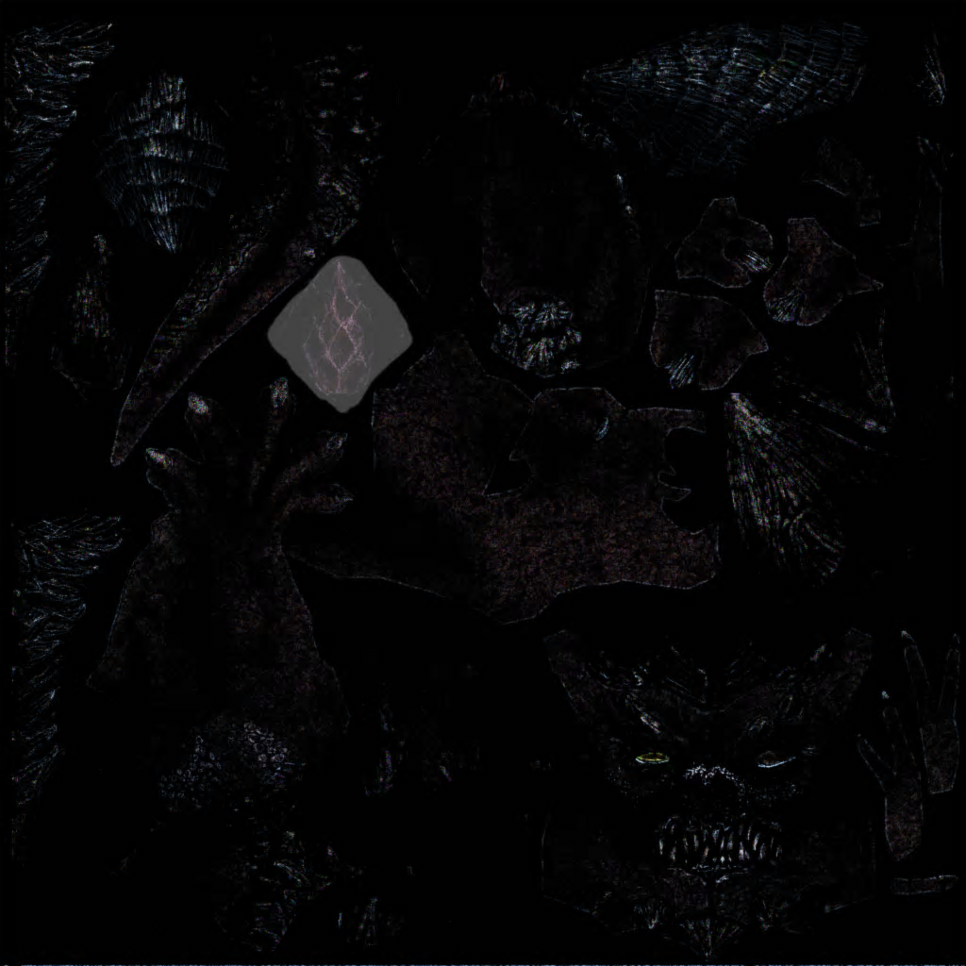
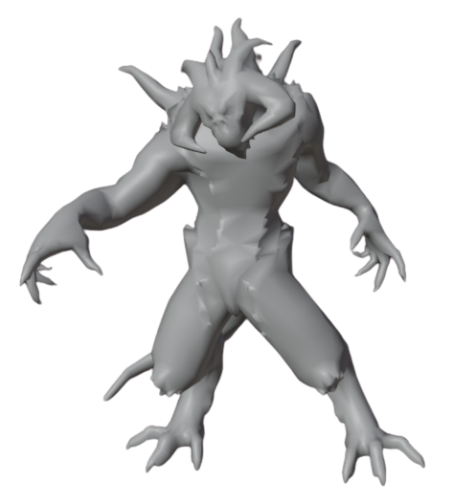
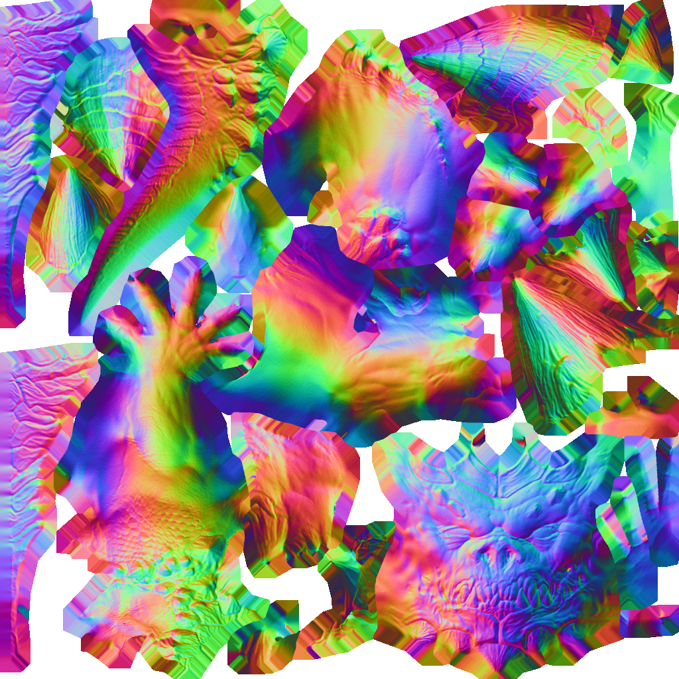
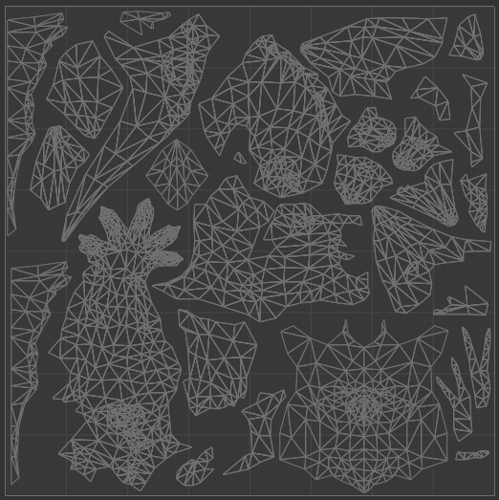
Texture

Slide 23

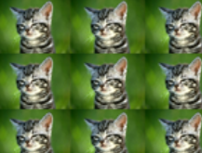
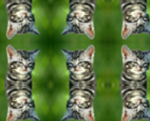

Texture
Texture Wrapping:
V
Texel
U

Slide 24
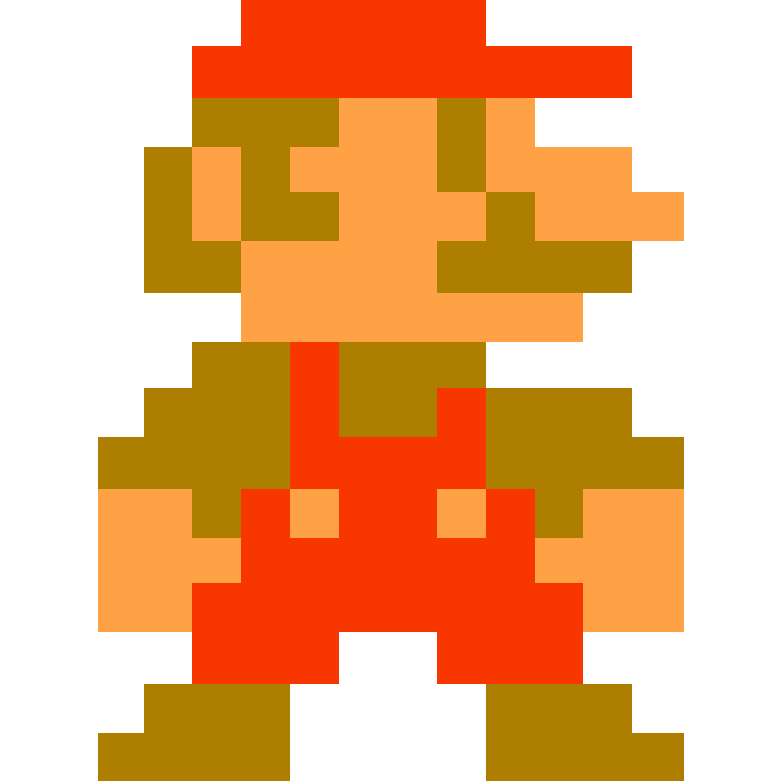

Texture Filtering
Nearest
Bilinear

Slide 25
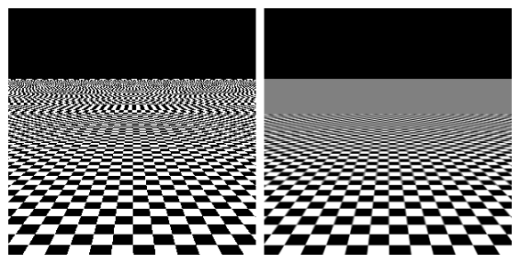
Mipmaps
Texture Aliasing
With Mipmaps

Slide 26


Mipmaps

Slide 27

: Fixed Stage
Programmable Pipeline
: Programmable Stage
Primitive Assembly
Vertex Data
Vertex Shader
Per-Sample Operations
Fragment Shader
Rasterization

Slide 28








Shader
Tessellation Control/Evaluation Shader
Compute Shader
Vertex Shader
Fragment Shader
Geometry Shader

Slide 29

Painter’s Algorithm (Depth-Sort Algorithm)
Advantages:
More Simple
Lower Memory Requirement
Limitations:
Cyclic Overlapping Problem
Lower Efficiency

Slide 30


Z-Buffer
Store depth Information per pixel

Slide 31




Perspective-Correct Texture Mapping
Affine
Perspective
Proof: http://www.lysator.liu.se/~mikaelk/doc/perspectivetexture/

Slide 32
Alpha Blending

Slide 33




Back-face Culling
Signed Area

Slide 34
Conclusion
Features
Shader
Wavefront OBJ/MTL Loader
Deferred Shading
SSAO
Bloom
Blinn-Phong Shading Model
Shadow Mapping
Normal Mapping
Cubemap
No dependencies
https://github.com/alanjian85/box

Slide 35
Q & A

